Slide 1
arcatech
…testing tomorrows telecoms
emutel™ Harmony

Slide 2
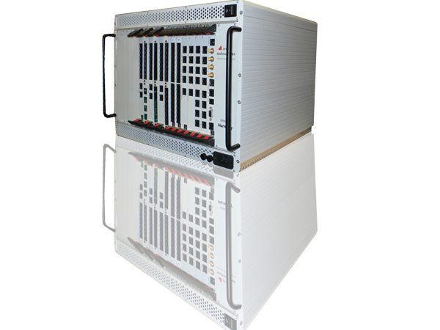
arcatech
…testing tomorrows telecoms
Agenda
1. Introduction to arcatech Ltd
2. emutelTM Harmony Overview
3. Testing Strategy
4. Mixed Test Cases
5. Test reports
6. Clout Harmony Test Concept

Slide 3
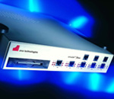
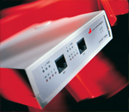
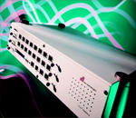
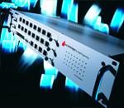
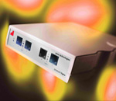
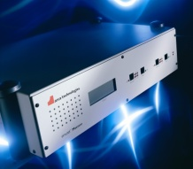
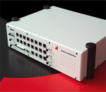
arcatech
…testing tomorrows telecoms
About Us
arcatech
Based Lisburn, United Kingdom
Design, manufacture and support telecom testing equipment
Arcatech’s products have been providing test solutions for over 20 years

Slide 4
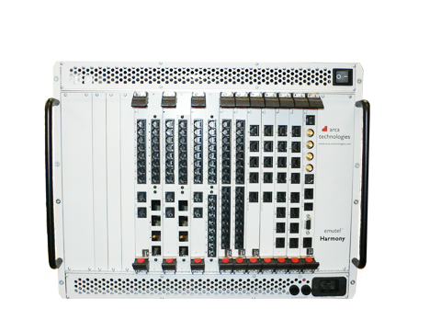
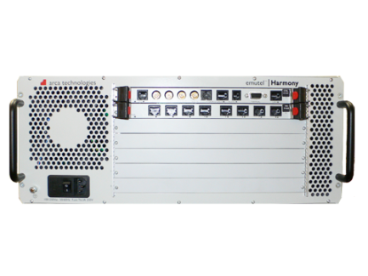
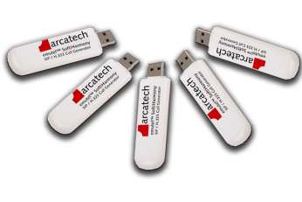
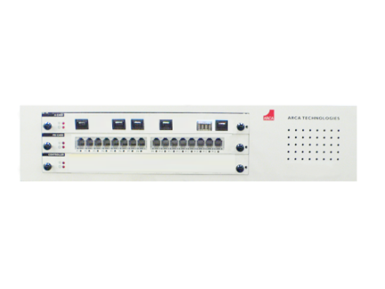
arcatech
…testing tomorrows telecoms
emutel™ Harmony Chassis Options:
soft|harmony
USB dongle
SIP / H.323 Bulk Call Generator
harmony|compact
1 card system
Network Simulation Call Generation VoIP, ISDN, POTS
harmony|developer
5 card system
Network Simulation Call Generation VoIP, ISDN, POTS
harmony|enterprise
15 card system
Network Simulation Call Generation VoIP, ISDN, POTS

Slide 5
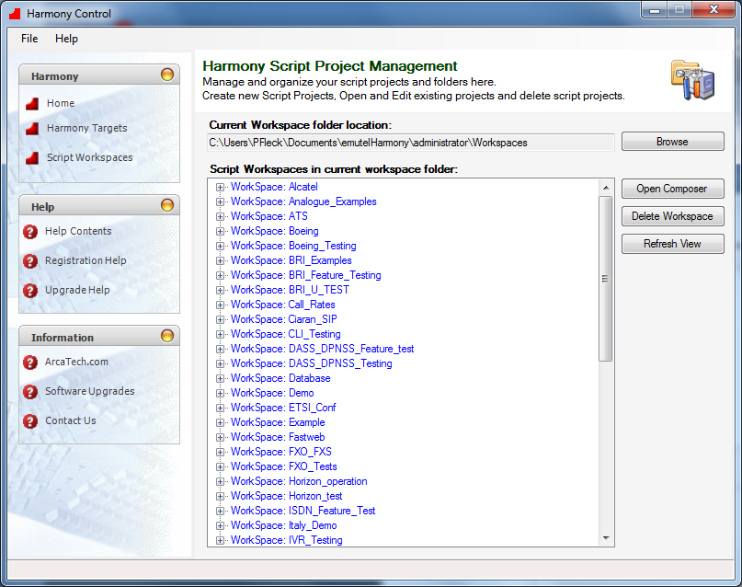
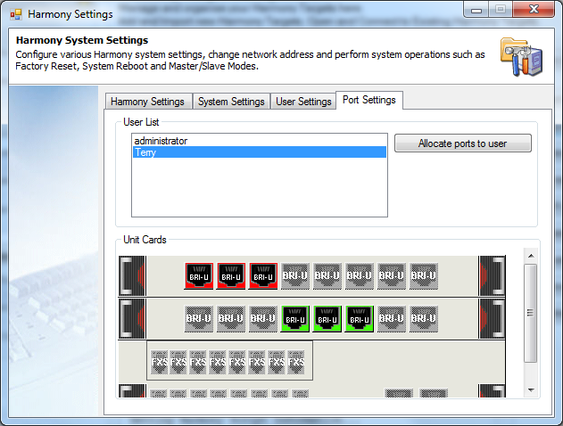
arcatech
…testing tomorrows telecoms
emutel™ Harmony Control Application:
Control application – used for system management.
Unit configuration and upgrade.
Script/Test case management.
Multi-user configuration.

Slide 6
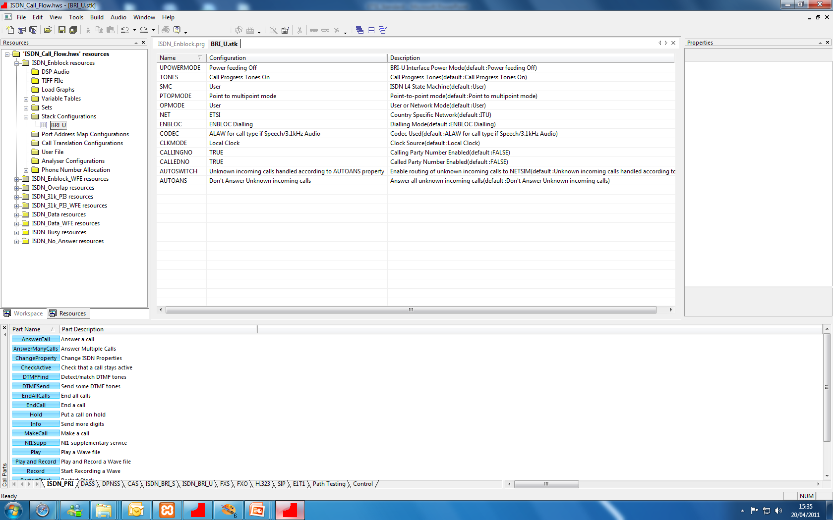
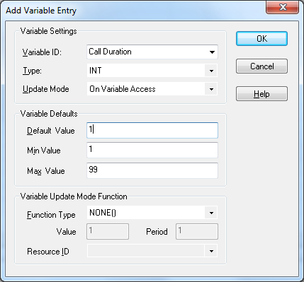
arcatech
…testing tomorrows telecoms
emutel™ Harmony Composer Application:
Composer – used for script test case creation
Script resources - enables you to add audio files, list of
telephone numbers
Configure individual call part parameters
Setup stack parameters
Create variables

Slide 7
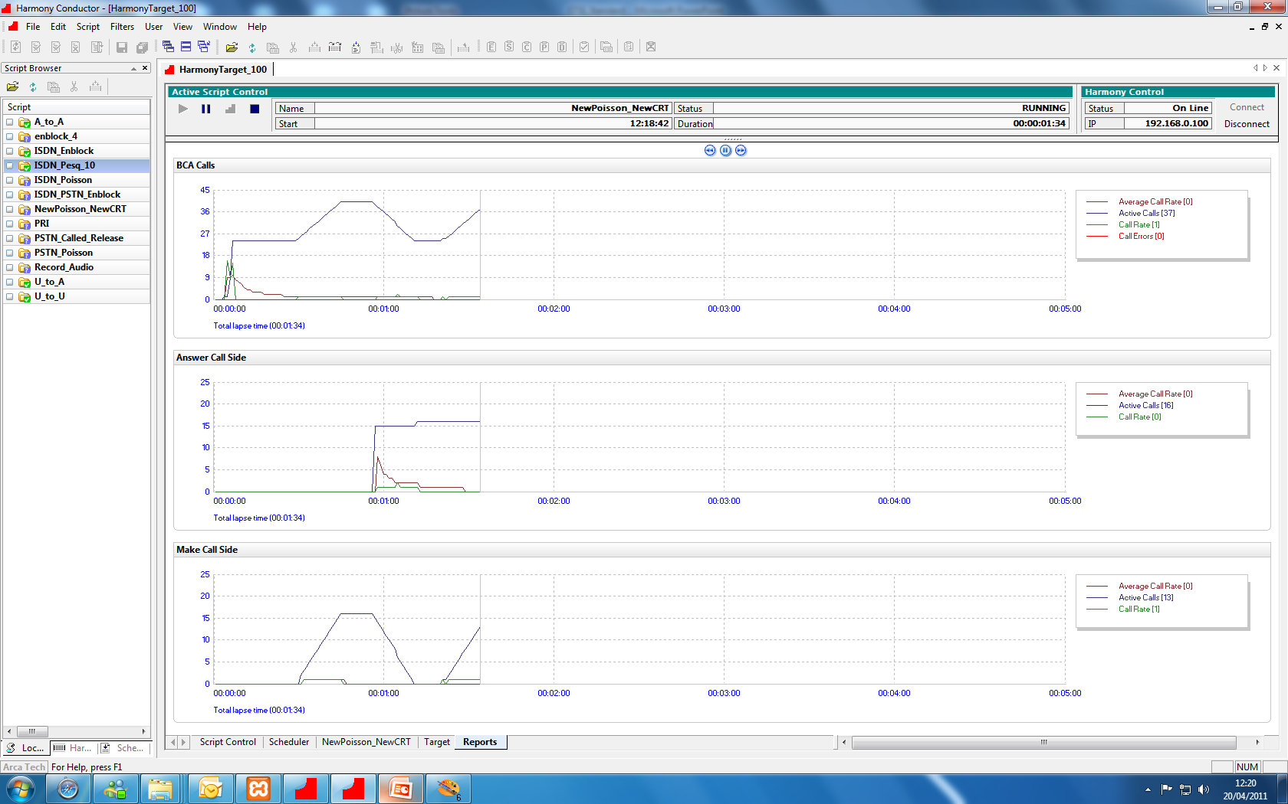
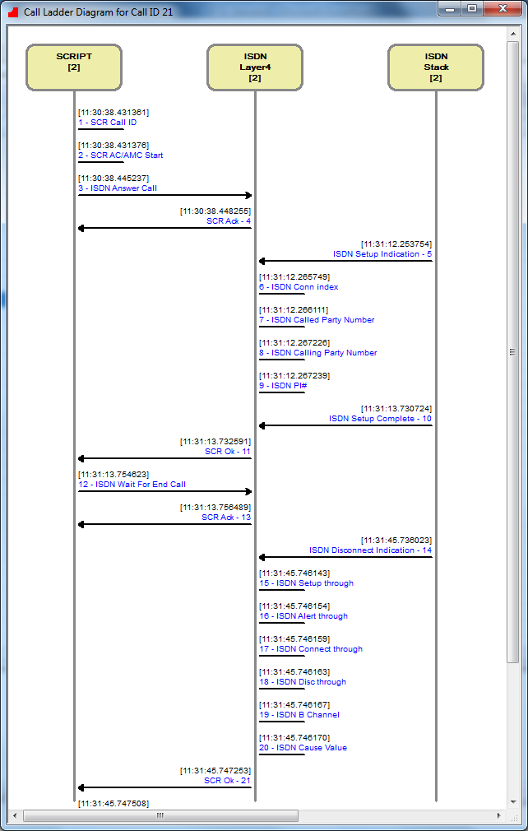
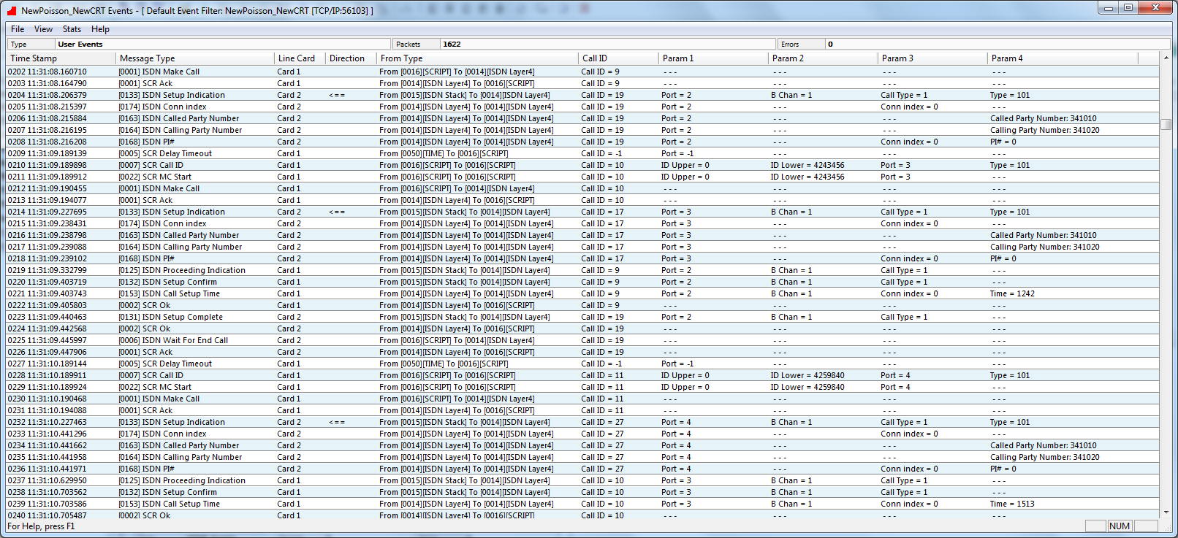
arcatech
…testing tomorrows telecoms
emutel™ Harmony Conductor Application:
Conductor – used for script execution and analysis of results
Live indication of running script.
Live graphing indicating active calls and call rates over time.
Call Ladder Diagrams.
Call Events.

Slide 8
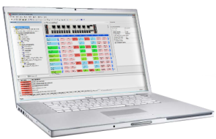
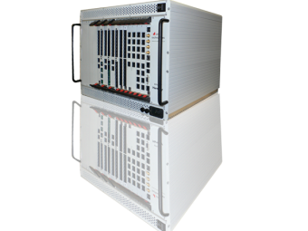
arcatech
…testing tomorrows telecoms
BRI Euro-ISDN
ISDN Fax
emutel™ Harmony features:
BRI Card 8 ports (example)
Multiple Interfaces supported in one system.
Multiple protocols supported simultaneously on each line card.
Ports configurable to be either Network or User side.
Individual port configuration, allowing for multiple test scenarios in
one script.
Multiple units controlled as if they were all one.
BRI NTT
PESQ

Slide 9
arcatech
…testing tomorrows telecoms
Developing a testing strategy:
ISDN – ISDN
Speech calls, with DTMF digits or Voice transmitted
3.1kHz audio, Fax or Modem, Data calls, with BERT
ISDN – PSTN
Speech calls, with DTMF digits or Voice transmitted, 3.1kHz audio, Fax or Modem
PSTN – ISDN
Speech calls, with DTMF digits or Voice transmitted, 3.1kHz audio, Fax or Modem
PSTN – PSTN
DTMF digits or Voice transmitted, Fax, Modem
Interface types to be tested
PSTN, ISDN, VoIP
Call types to be made
Speech, 3.1kHz Audio
Fax, Data
Quality tests to be performed
PESQ, BERT
ETSI introduced standard
ETSI TS186 025-2

Slide 10
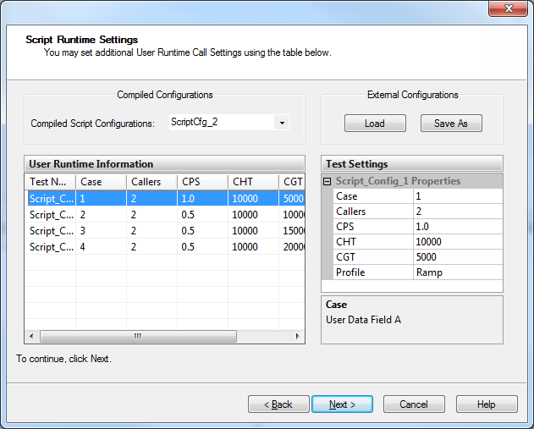
arcatech
…testing tomorrows telecoms
Mixed test cases:
The different test cases required can be
combine into one script.
Ability to specify the number of calls, call rate,
hold time and guard time for each individual test
case.
Facility to save particular test configurations to
be used later for regression testing

Slide 11
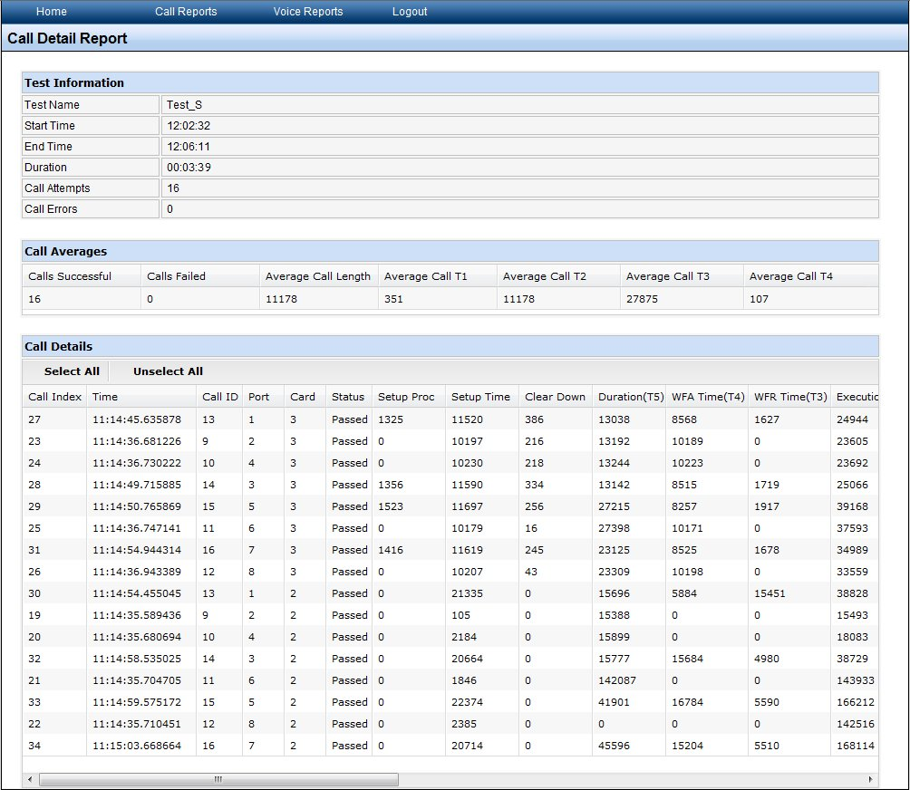
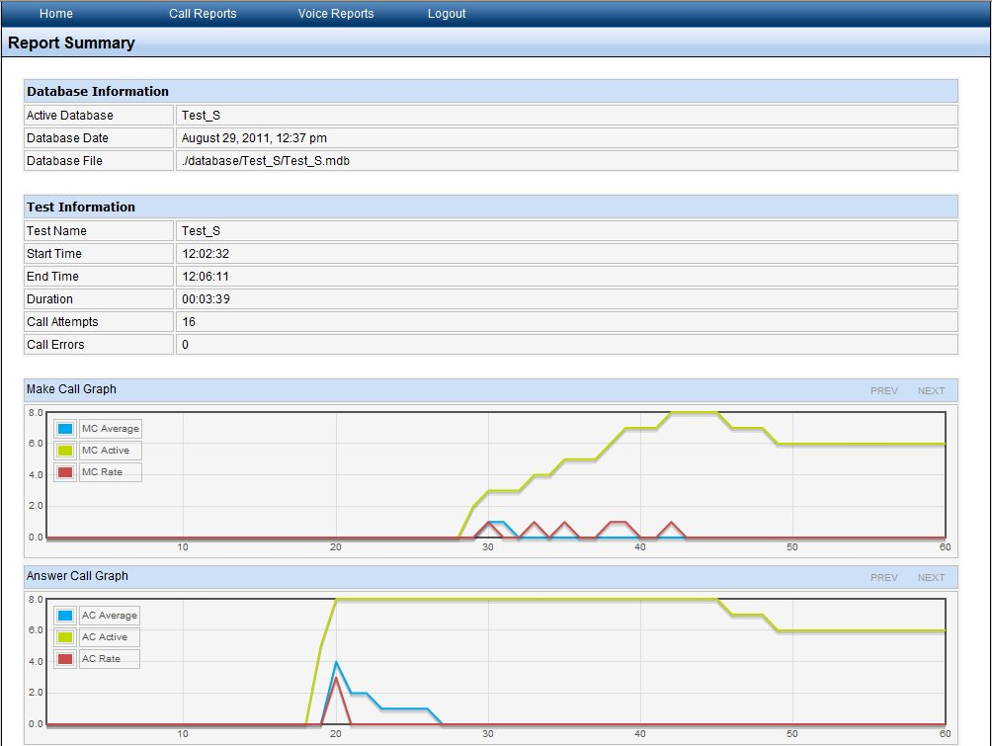
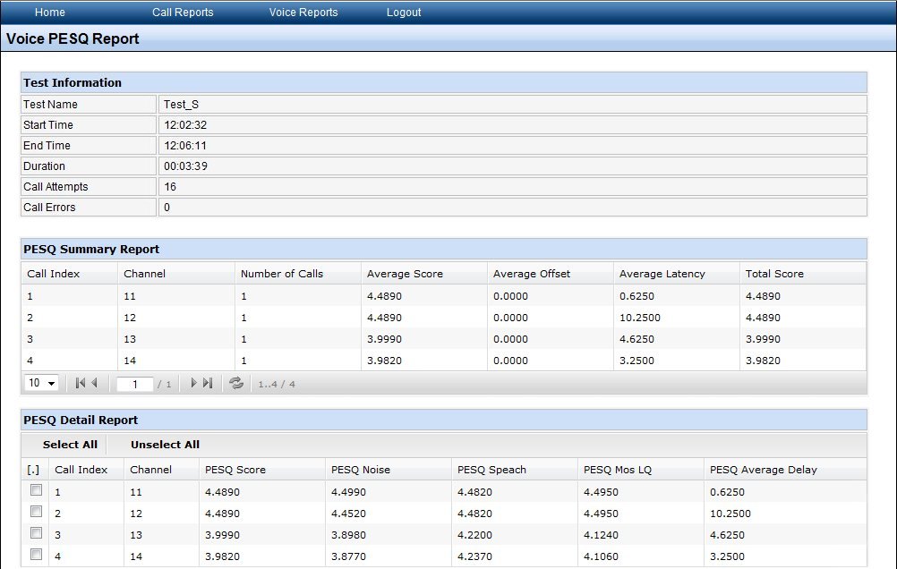
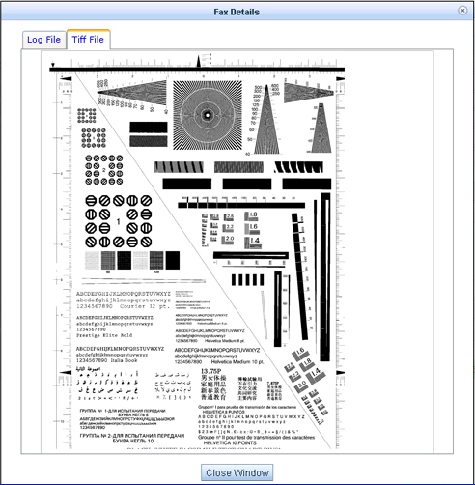
arcatech
…testing tomorrows telecoms
Test Reports:
Reports can be generated for each test carried out on the Harmony.
Summary Reports :
Test duration, Calls Attempts, Call Errors
Detail Reports :
Details of port used, Setup time, Called Party, Calling Party numbers, Call duration, Setup through time, time for Setup message to be transmitted through system under test.
PESQ Reports :
PESQ score, System through Delay
FAX reports :
Details, Quality, Image

Slide 12
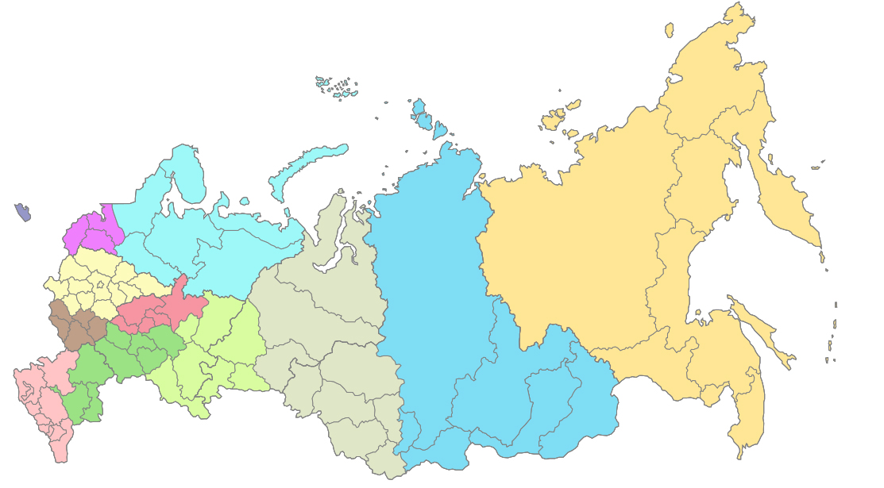
arcatech
…testing tomorrows telecoms
Concept: Test the whole network:
Real world testing of assets across live network
Schedule and analyse traffic with voice
measurement
Measure real time delay
Understand your network better
Example of a typical network scenario
Key:
asset
harmony unit

Slide 13
arcatech
Harmony|cloud: overview
…testing tomorrows telecoms
Concept: Test the whole network:
cloud web server
WAN
PC
deploy commands
connect to server
User management, Control & Synchronise units,
Script deployment, Scheduler, Firmware upgrade, Unit authorisation, License management
View Reports, Set up notifications
Administer units under test, Remote testing
request commands
Network
ISDN, VoIP, POTS
Network
ISDN, VoIP, POTS
Key:
TCP Protocol
Network Traffic
St. Petersburg
Moscow
Krasnoyarsk
Scripts on unit run & information is sent back to server
Each harmony unit can work together or independently

Slide 14
arcatech
…testing tomorrows telecoms
Thank You
arcatech Ltd
www.arcatech.com
sales@arcatech.com
+44 (0)28 92 677 204

