Slide 1
arcatech
…testing tomorrows telecoms
emutel|Symphony
presentation

Slide 2
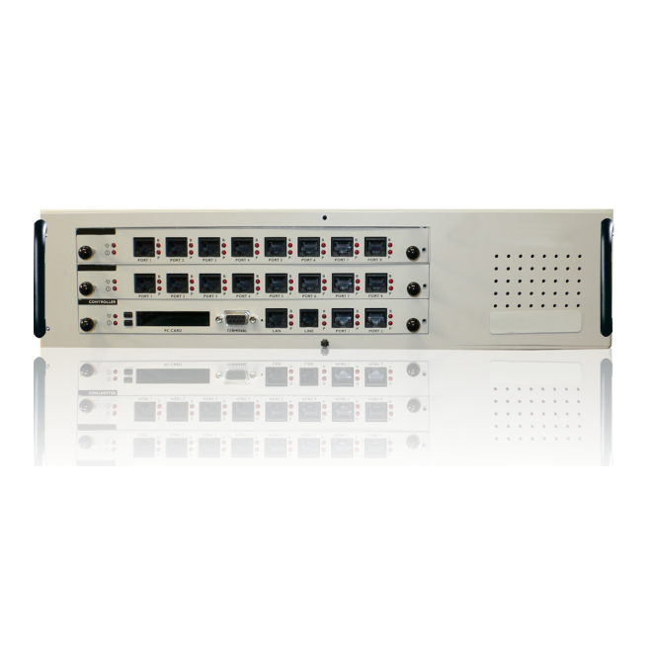
Unit Operation
The emutel™|Symphony is a network simulator facilitating the testing of ISDN and Analogue equipment.
Each port on the emutel™|Symphony can be configured with its own telephone number so calls can be made between different ports on the unit, in order to test the operation of different pieces of equipment.
With support for different protocols the emutel™|Symphony is idea for testing equipment to be used in other regions around the world.

Slide 3
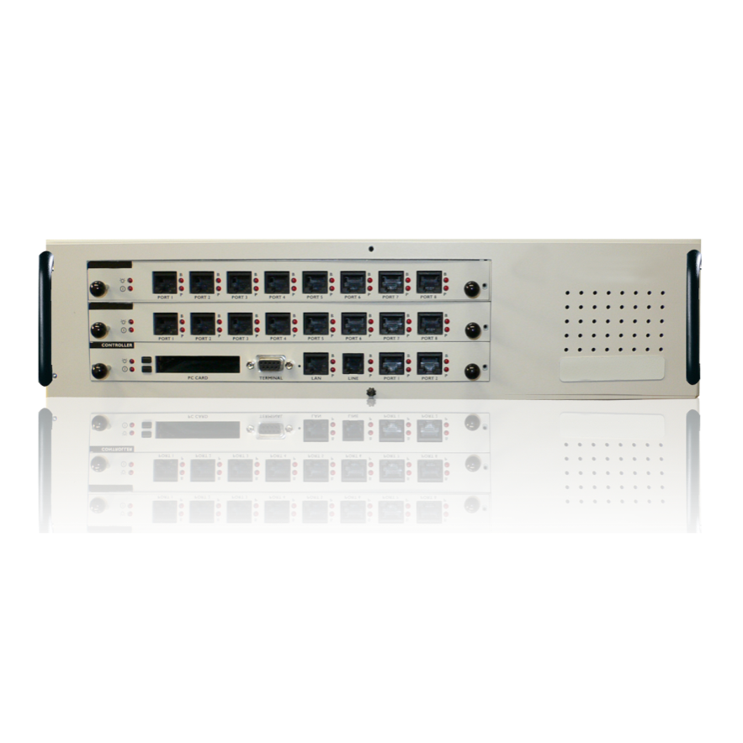
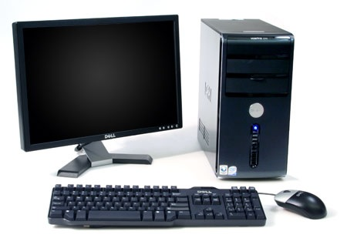
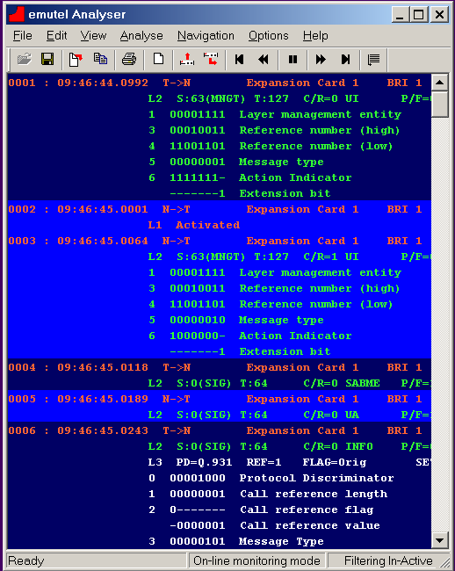
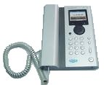
Example Application
In this example, an emutel™|Symphony is providing network interfaces to verify the operation of customers equipment. The windows application provides ease of configuration and Protocol Analysis

Slide 4
Available Cards
Control card
Communication using either Serial, Ethernet or Modem connection.
With the use of PCMCIA cards the network protocol supported by the unit can be changed.
The Control card also has space for two ports of either BRI or PRI ISDN.
BRI-S card
8 ports each individually configurable to have either 40V 1Watt power feeding, have restricted power feeding or to have power feeding turned off.
Ports can also be set to either Point–to–Point or Point–to–Multipoint operation.
BRI-U card
8 ports each individually configurable to have either 88V 5Watt power feeding, have Sealing power feeding (current limited) or to have power feeding turned off.
Ports can also be set to either Point–to–Point or Point–to–Multipoint operation.

Slide 5
Available Cards
Analogue card
16 ports which provide -48V line feed.
The port Line Impedance can be changed to match that of a number of countries, also tones can be changed to match the country selected.
PRI card
8 ports which are individually configurable between E1 and T1 and the various different framing modes offered.

Slide 6
Unit Features
Windows Application
Proprietary windows application, allowing simple changing/saving of unit settings & easy filtering of protocol analysis, etc.
Telephone no. setup
Each ports telephone number can be changed to match the specific dialling plan required.
Test Tones
Dial, Busy, Error, Ring and Custom Tone 300Hz – 3400Hz @ +3dBm to -26dBm
Protocol Analyser
Shows the L1, L2 & L3 messages on the D channel in HEX, ACSII Short and ASCII Long
Supplementary services
Mainly on the ETSI & N.American networks
Extra add-on features like 3PTY CONF, ECT, HOLD, CFU, CFB, CFNR, CD,
MCID, AOC, CW, etc.
D Channel Packets
X.25 on BRI1/BRI2
100 logical calls in DCE mode
Semi-permanent connection
Semi-permanent/nailed-up connection on BRI/PRI B channels

Slide 7
Thank You
arcatech Limited 210-212 LEO Ballinderry Road
Lisburn
Northern Ireland
BT28 2SA
Tel: +44 (0)28 9267 7204
Fax: +44 (0)28 9260 5353
sales@arcatech.com
www.arcatech.com

